Slide 1
Accessing the curriculum for diverse learners
Universal Design for Learning cont’d

Slide 2

Universal Design for Learning
A framework and set of principles that gives students equal opportunities to learn
Based on current brain research
Flexible approaches that are individualized

Slide 3

Universal Design for Learning
Addresses the norm – diversity of learners
Planning, teaching and assessing are done from the outset, minimizing the need to changes after the fact
High standards and expectations maintained

Slide 4

Universal Design for Learning
3 primary principles:
multiple means of representation (the what of learning)
multiple means of action and expression (the how of learning)
multiple means of engagement (the why of learning)

Slide 5

Video: UDL in Action – an Alberta Story

Slide 6
Assistive Technology
Access to the school
Ramps
Electronic doors
Playground accessibility
Elevators
Hall rails
Bathroom access
Universal signage
Braille
What else?
In the classroom
Adequate floor space
Clustered tables
Lowered shelf height
Variety of chairs
Various writing utensils
Adjustable desk and tables
Appropriate digital devices
What else?

Slide 7
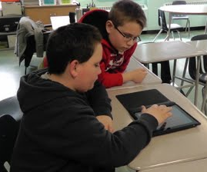
How will we use it?
Aids to understand or remember
Manipulate or control the environment
Seating and positioning
Enhance communication
Facilitate peer relationship
Support strength based approaches
What else?

Slide 8
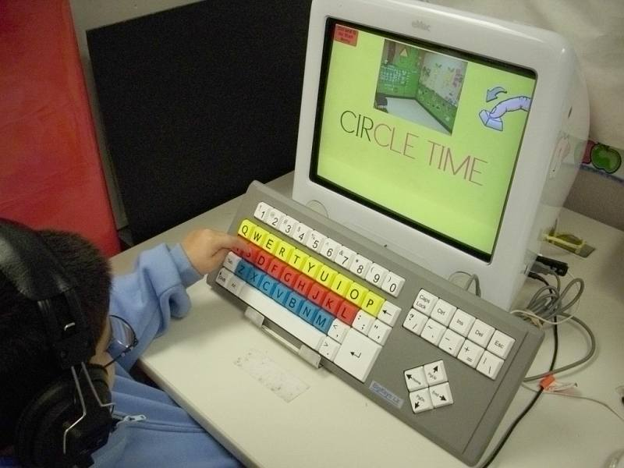
“I can soar” video
National Center for Technology Innovation (NCTI)
Series of videos (with education kits) about the use of assistive technology in the classroom

Slide 9

Textbook discussion
Discuss examples of the points made in the various charts about how UDL is implemented in classroom.
What remains unanswered?

Slide 10
Instructional Cycle
Gather
Plan – collaborate, arrange and distribute
Implement – monitor and assess
Evaluate and reflect
Begin new cycle
Role of EA is to support teacher and students
Different skills are needed at each stage
Critical to examine how to strengthen own skills to remain a competent, current and contributing educator

Slide 11
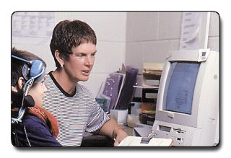
Activity: EA Role
Consider the instructional cycle along the two dimensions of student and classroom demands.
What will you be doing pre, during and post instruction?

